Slide 1
Compliance
Technical - Overview
Integration Team
2018

Slide 2
AGENDA
Overview
Flows
Rules
Structure Types, Logical Fields
Bulk Vs Single mode

Slide 3
“
Compliance interface is a standard GPP SP interface defined based on the Fndt Message structure to streamline the process of integrating GPP with Financial Institution’s Compliance system”

Slide 4
SEND REQUEST flow
Account Lookup
Internet Banking, Branch-OTC, SWIFT, Local Clearing
Receive Payment Instruction
Payment Initiation
Debit Side Processing
Credit Side Processing
Compliance
Incoming Check
Wait Behaviour Wait OFAC
Outgoing Check
FX Engine
The same request may be used for both Compliance exit points. The difference is in the message formatting, where the second interface call may trigger the appropriate Mapping Out and, when required a specific formatter (for instance SWIFT for SWIFT MOP).
SWIFT, Local Clearing
Payment execution
Fees Processing
MOP Selection Value Date and Cut Offs
Available at every complete or intermediate status
Accounting System
Balance Inquiry
Advising System

Slide 5
RESPONSES flow
Account Lookup
Internet Banking, Branch-OTC, SWIFT, Local Clearing
Receive Payment Instruction
Payment Initiation
Debit Side Processing
Credit Side Processing
Compliance
First Response
Wait Behaviour Wait OFAC
FX Engine
The First Response is returned in a case when the Compliance system found a possible hit and an investigation is conducted to check if indeed this is a hit. In this case a Second response will follow after the investigation is complete with the final resolution.
SWIFT, Local Clearing
Payment execution
Fees Processing
MOP Selection Value Date and Cut Offs
Available at every complete or intermediate status
Accounting System
Balance Inquiry
Advising System

Slide 6
RESPONSES flow
Account Lookup
Internet Banking, Branch-OTC, SWIFT, Local Clearing
Receive Payment Instruction
Payment Initiation
Debit Side Processing
Credit Side Processing
Compliance
Second Response
Wait Behaviour Wait OFAC
FX Engine
The Second (or last) Response is returned either as a final response in a case when the Compliance system found a possible hit, returned a First Response, and an investigation was conducted, or when the Compliance system provides only its final response.
SWIFT, Local Clearing
Payment execution
Fees Processing
MOP Selection Value Date and Cut Offs
Available at every complete or intermediate status
Accounting System
Balance Inquiry
Advising System

Slide 7



COMPLIANCE rules - TBU
Rules should be set up in order to invoke the Account Lookup interface for the debit or credit account in cases they belong to a customer (relevant side MOP is BOOK), and as per specific FI business scenarios and conditions.
These rules are invoked whenever a debit or credit account of a message is not found in GPP, or is found but the Check CDB check box is selected, indicating that the master copy for this account resides in the FI’s external system.

Slide 8
Single mode
Account Lookup
Internet Banking, Branch-OTC, SWIFT, Local Clearing
Receive Payment Instruction
Payment Initiation
Debit Side Processing
Credit Side Processing
Compliance
GPP invokes the Compliance interface for the following payments:
Incoming: Invoked for the received only
Outgoing: Invoked for the send out only
FX Engine
SWIFT, Local Clearing
Payment execution
Fees Processing
MOP Selection Value Date and Cut Offs
Available at every complete or intermediate status
Accounting System
Balance Inquiry
Advising System

Slide 9
BULK mode - TBU
For Source side GPP SP is working in Sync mode, which is single interface.
On the source side, where an account in the PmntInf level is the same for all the transactions in same level, GPP invokes the interface for the first transaction only and stores the received information in the system cache. For all subsequent transactions in the level, GPP retrieves the account information from the cache.

Slide 10
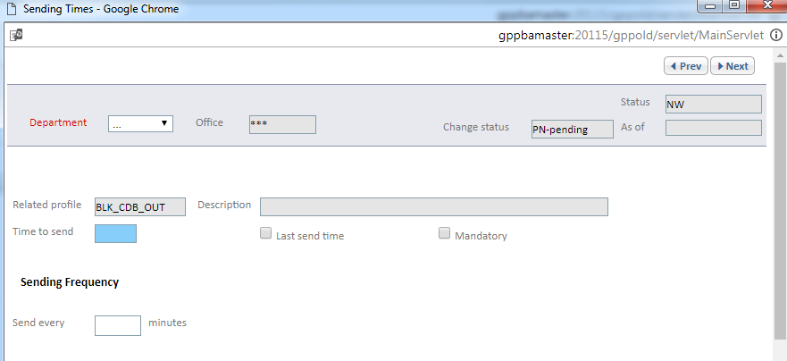
Single Vs bulk mode - TBU
When processing a transaction file, GPP invokes the interface for each transaction in the file.
GPP executes the target-side Account Lookup interface in asynchronous mode (because of the large number of customer accounts in the GPP database) and improves performance by not implementing timeout and retry functionality for the interface. The generation of file request is triggered by sending time mechanism .

Slide 11
Response return codes
When using the Standard Fndt Message, the FI can also directly use the GPP internal numeric return codes to indicate the nature of the Sanctions second response:
0 - Hit
1 - No Hit
2 - Seized Funds
990 - Processing / technical error
Note: If No Hit, transaction continues to be processed.
If a Hit or Error, GPP routes the transaction to an exception queue, based on the received error code:
Hit - route to OFAC_POSSIBLE_HIT
No Hit - continue processing
Failure - message is routed to REPAIR
Invalid - message is routed to REPAIR

Slide 12
Thank you
Arnab Podder
Integration Team
arnab.podder@dh.com

